Slide 1
No-Show

Slide 2
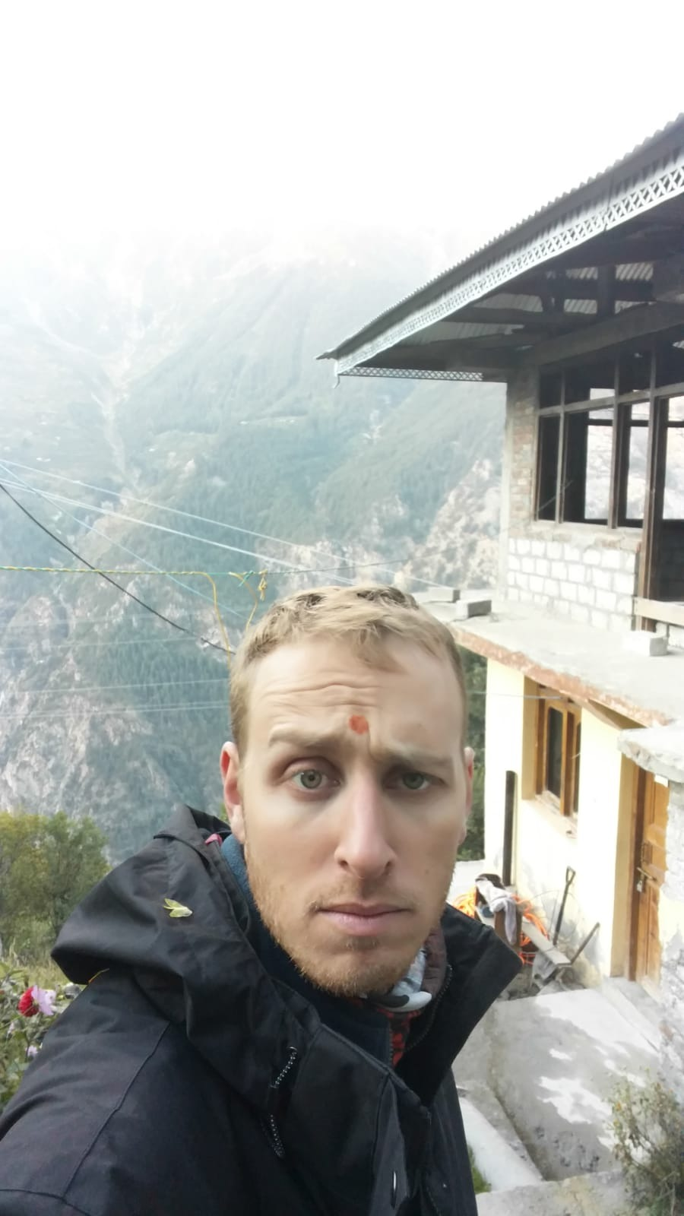
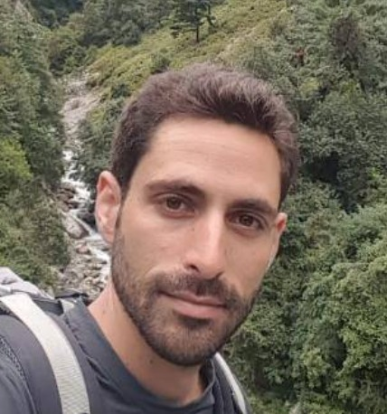
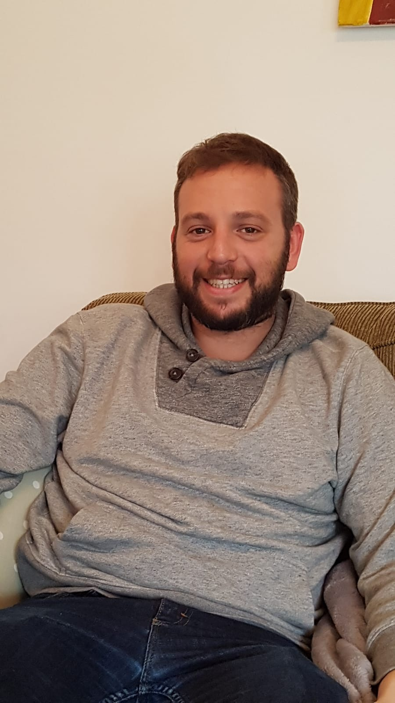

Our team
CEO
Itamar Lapidot
CTO
Ori Port
CFO
Asaf Amitai
Program developer
Raj Capoor

Slide 3
Project analysis slide 2
The No-Show problem
ANALYSIS
SPECIFICATION
IMPLEMENT
DESIGN
TESTING
DEVELOP

Slide 4
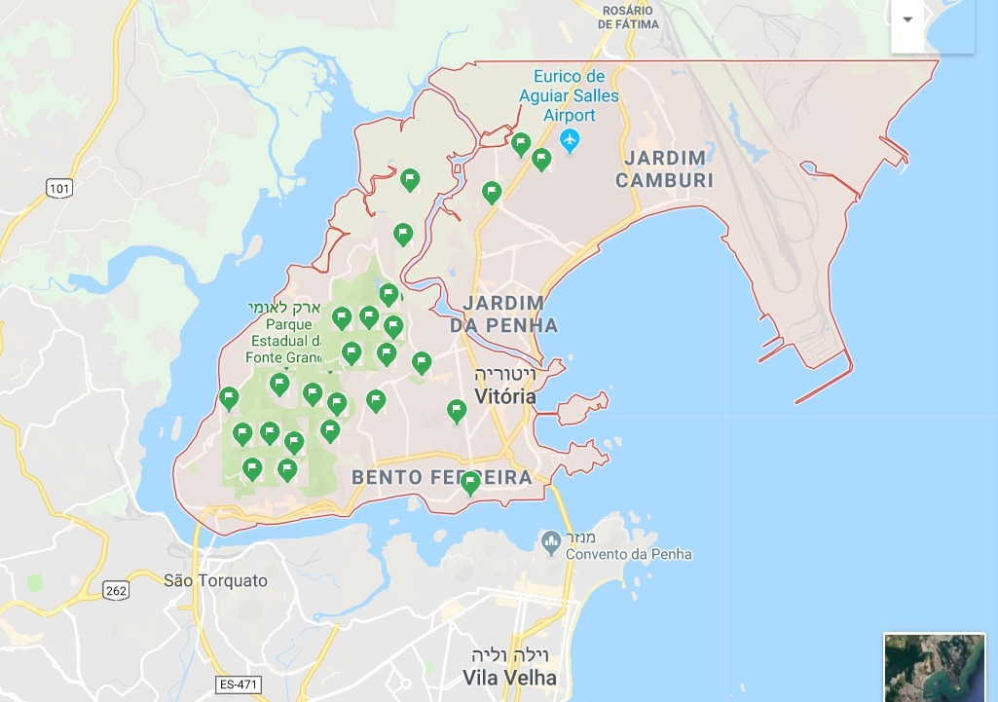
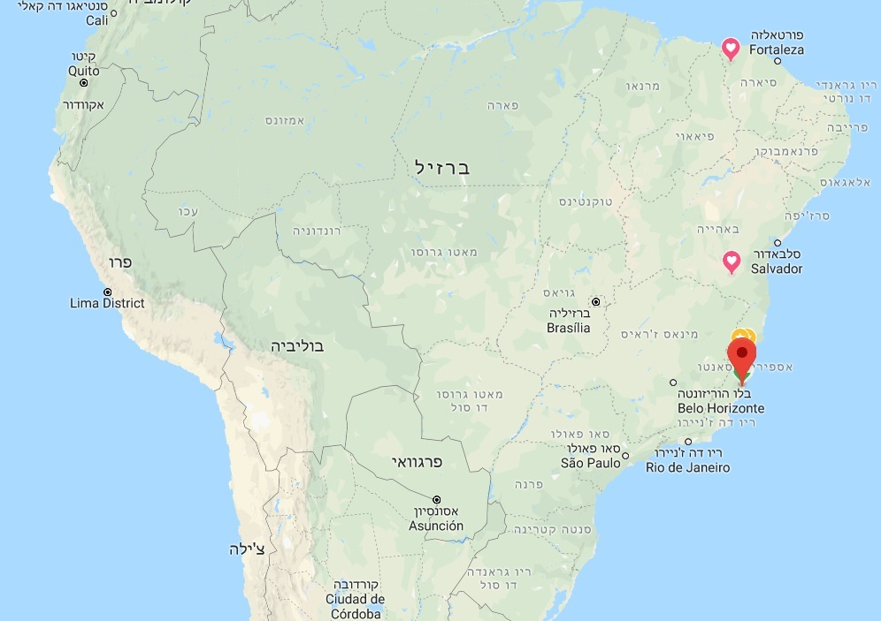
Project analysis slide 6
Analysis process
Added the weather inputs.
Change nominal to Binary > Get_dummies
Splitting the data (ages).
.

Slide 5
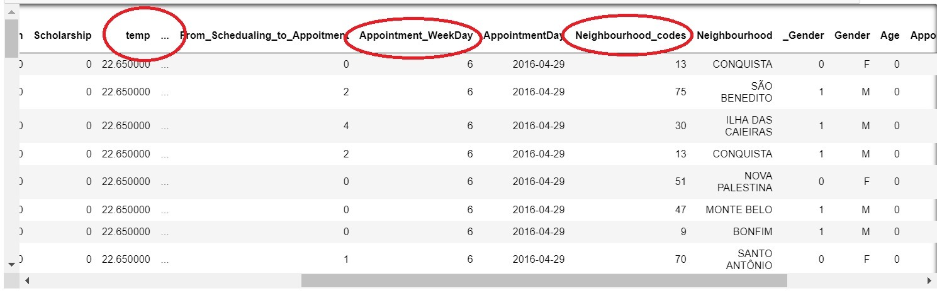
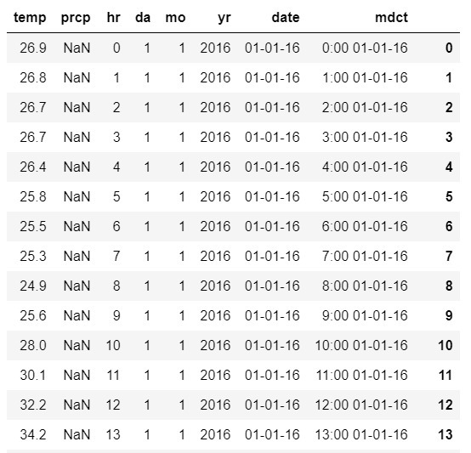
Project analysis slide 6
Analysis process
Added the weather inputs
Change nominal to Binary > Get_dummies
Splitting the data (ages)
.

Slide 6
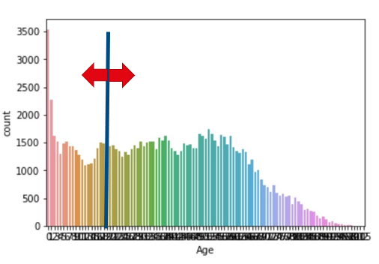
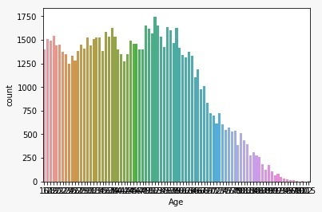
Project analysis slide 6
Analysis process
Added the weather inputs
Change nominal to Binary > Get_dummies
Splitting the data (ages)
.

Slide 7
Project analysis slide 6
Analysis process
Added the weather inputs
Change nominal to Binary > Get_dummies
Splitting the data (ages).

Slide 8
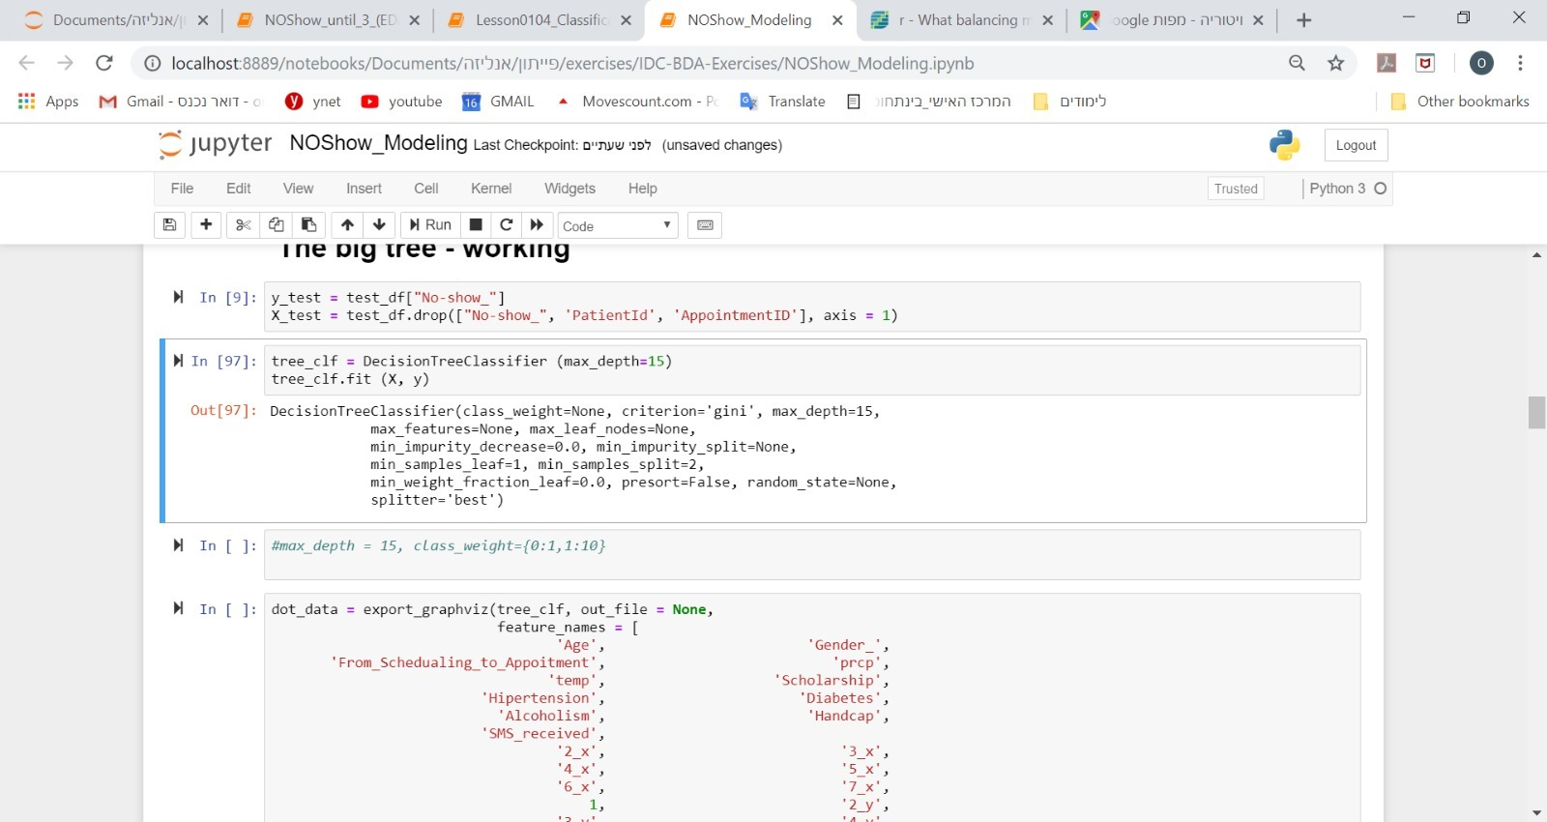
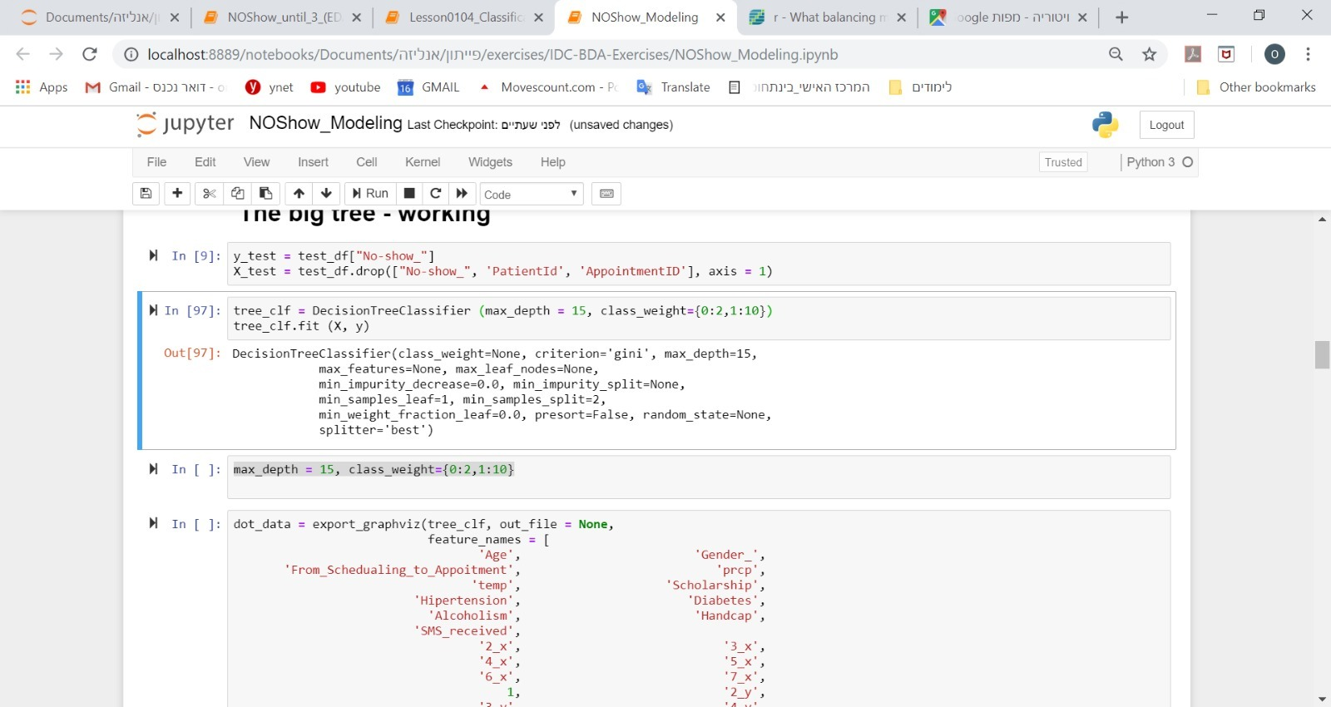
Project analysis slide 5
Model- Decision Tree
Big tree first attempt
Precision 38%
Recall 8%
Our challenge- Hard to predict
Unbalanced Y ~(20%)
TRUE\PREDICT | SHOW | NO SHOW
SHOW | 13314 | 486
NO SHOW | 3110 | 301

Slide 9
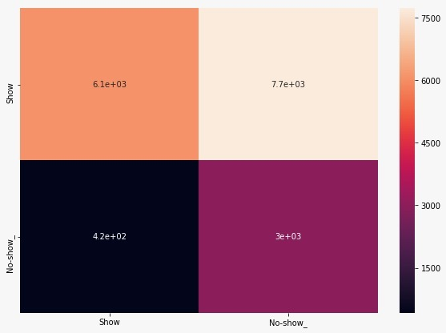
Project analysis slide 5
Model- Decision Tree
Big tree results
Precision 28%
Recall 87%
TRUE\PREDICT | SHOW | NO SHOW
SHOW | 6071 | 7729
NO SHOW | 416 | 2995

Slide 10
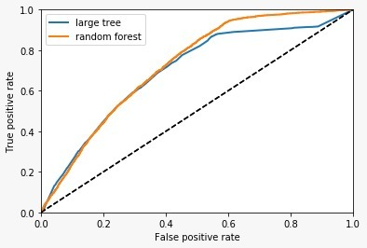
Project analysis slide 5
Model- Random Forest
Big Tree To Random Forest
Precision 28%->28%
Recall 87% -> 94%
Future steps:
Data enrichment->improve precision
Use other prediction tools ( GBM… XGB)

Slide 11
Project analysis slide 4
Business Plan
Registration
Car pull
S
feedback
More business opportunities
Product
Airlines
Chatbot
human response
Collecting data
Data Enrichment
Restaurants
Car pull
Notes:
Registration – recommend per patient based on our prediction modules.
Smart Chatbot.
Low cost of development ad maintenance.
Initiate chats– feedback.
Collecting data, updating prediction modules.
Suggest smart re-scheduling.
Last resort – human response.
Enrich our data from the costumers data base.

Slide 12
Thank You

Slide 13
Pricing
An initial consultation with a doctor will cost in the range of $100 – $200.
Each consultation is taking approximately between 20 to 30 minutes.
Predicate the problematic patients.

Slide 14
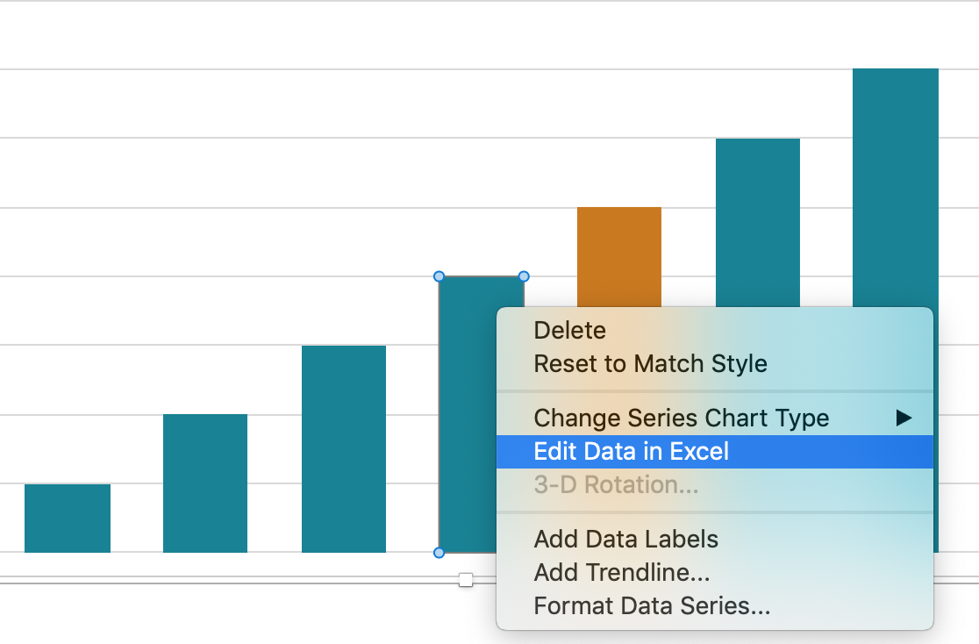
Project analysis slide 11
Editing Data
Slides
If you would like to modify the data in the graphs and chart included in this template, simply right click on the diagram and select Edit Data in Excel.
Excel will then open and you can edit the relevant data.

Slide 15
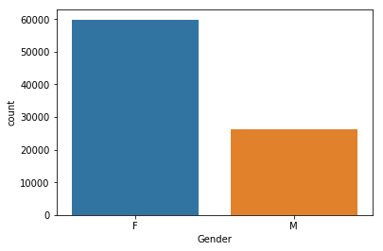
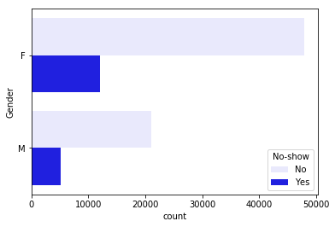
Project analysis slide 5
Gender
There isn’t proportions difference between men and women "no-show"
Women visits doctor more often than men

Slide 16
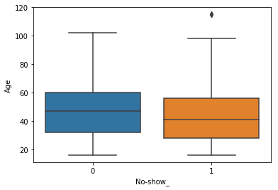
Project analysis slide 5
Ages
No-show trend address all ages, however, it’s more common among younger visitors

Slide 17
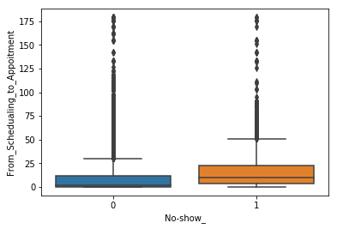
Project analysis slide 5
Scheduling
As more as the gap between the scheduling date to the appointment date is longer, therefore the No-shows are more common.

Slide 18
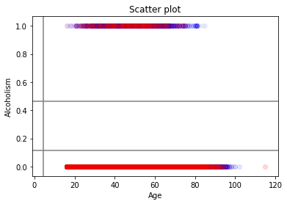
Project analysis slide 5
Alcoholism VS Age
more no-shows have bigger gap between the schedualing to the appoitment date than the shows.

